Slide 1
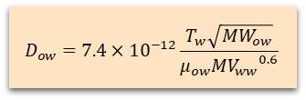





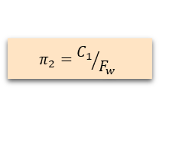





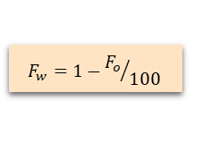



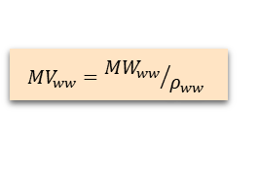




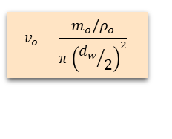
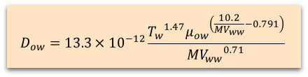
Matzain (Single Phase) Sub routine
Define $P_{io}, T_{oi}$
Get $ρ_{o}$
from TAB table
Define $P_{io}, T_{w}$
$$v_{o}=\frac{m_{o}/ρ_{o}}{π{\left({d_{w}}/2\right)}^{2}}$$
Get $ρ_{ow},μ_{ow}$ from TAB table
Get $ρ_{ww},{MW}_{ww},{MW}_{ow}$
from WAX table
Define $m_{o}$
Define $d_{i}, d_{w}$
$$δ_{d}=\frac{d_{i}−d_{w}}{2}$$
$$N_{SR}=\frac{ρ_{ow}v_{o}δ_{d}}{μ_{ow}}$$
$${Re}_{ow}=\frac{ρ_{ow}v_{o}d_{w}}{μ_{ow}}$$
$$F_{o}=100\left(1−\frac{{{Re}_{ow}}^{0.15}}{8}\right)$$
$$π_{1}=C_{2}{N_{SR}}^{C3}$$
Define $C_{1},C_{2}, C_{3}$
$$π_{2}={C_{1}}/{F_{w}}$$
$$F_{w}=1−{F_{o}}/{100}$$
$${MV}_{ww}={{MW}_{ww}}/{ρ_{ww}}$$
Define $\frac{dC}{dT},\frac{dT}{dr}$
$$\frac{dδ}{dt}=\frac{π_{1}}{1+π_{2}}D_{ow}\frac{dC}{dT}\frac{dT}{dr}$$
Calculate $D_{ow}$
Wilke-Chang
$$D_{ow}=7.4×{10}^{−12}\frac{T_{w}\sqrt{{MW}_{ow}}}{μ_{ow}{{MV}_{ww}}^{0.6}}$$
$$δ=δ_{t−1}+\frac{dδ}{dt}dt$$
$$D_{ow}=13.3×{10}^{−12}\frac{{T_{w}}^{1.47}{μ_{ow}}^{\left(\frac{10.2}{{MV}_{ww}}−0.791\right)}}{{{MV}_{ww}}^{0.71}}$$
Hayduk-Minhass
End of time iteration
Internal

Slide 2



$α_{w}$ or $α_{c}$ calculator
$α_{w}$
$α_{c}$
$d_{h}=$
Internal

